Slide 1

Suggestion for customer running TFT8001280-12-E

Slide 2
About the module of 8001280-12 did not run on customer board, I suggest we should check from two places which is software and hardware.

Slide 3
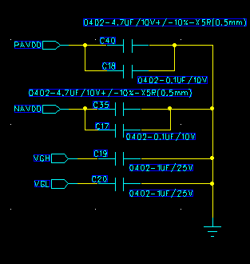
Hardware check
About hardware , firstly, Please check the voltage about VGH/VGL/PAVDD/NAVDD on module FPC, I want to confirm whether the voltage would provide for our module
VGH test location: C19
VGL test location: C20
PAVDD test location: C18
NAVDD test location: C17
FPC schematic diagram

Slide 4
Hardware check
Secondly, Please provide your connection schematic diagram for me ,I would check your hardware connection.

Slide 5
Software check
Concerning software , Please check your system about MIPI speed ,frequency, porch setting and dotclk.

Slide 6
Truly demo check
Concerning truly demo, Firstly, Could you Please test VGH/VGL/PAVDD/NAVDD on module FPC ,I want to know whether is abnormal voltage caused DEMO not running
Secondly , Please check the module of 8001280-12-E surface , I am worried module would be damage during transport
VGH test location: C19
VGL test location: C20
PAVDD test location: C18
NAVDD test location: C17

Slide 7
Thank you

